Slide 1

Pico and I2C
Using MicroPython
Steven F. LeBrun
October 8, 2022
Roanoke Robotics & Makers Club of Southwest Virginia

Slide 2
Overview
Raspberry Pi Pico
I2C Protocol
Raspberry Pi Pico and I2C
Programming I2C Devices for Pico
SSD1306 oLED Display
LCD Display
ADXL345 Accelerometer
References

Slide 3
Raspberry Pi Pico
The Pico is a microcontroller board – not a computer
Based on the RP2040 chip – Dual core ARM processor
Powered by 5V USB cable
GPIO Pins
  High -- 3.3V
  Low -- 0V or Ground
Supports I2C, SPI, UART communication protocols
3 available ADC pins

Slide 4
I2C Protocol
I2C, a.k.a. I²C, IIC, is formally called Inter-Integrated Circuit
Two-Wire Serial communications between low speed devices
  SDA – Serial Data
  SCL – Serial Clock
Multiple devices can be connected to the same SDA & SCL lines
One device is a master and the other devices are slaves
Each slave device identified with a unique 7 bit address

Slide 5
I2C Protocol
Transmission starts with the Master Device generating a Start Condition of SDA low and SCL high
First byte written by Master
  Contains Slave Address and the I/O bit
The I/O bit is bit 0 determines I/O direction
  High – Slave writes next bytes and Master reads them
  Low -- Master writes next bytes and Slave reads them
Transmission ends with Master Device generating a Stop Condition of SDA high and SCL high

Slide 6
I2C Protocol
Each [slave] I2C Device has its own protocol that is on top of I2C.
Device datasheets explain what those protocols are
Commonly, the first byte is a register or memory location on the slave device.
The next n bytes are the data read or written to and from the slave device.
The format of those bytes are defined in the device datasheet

Slide 7
Pico – I2C GPIO Pins
The Pico, like the Raspberry Pi, has two I2C buses.
  Labeled I2C0 for I2C Bus 0, and I2C1 for I2C Bus 1
On the Raspberry Pi, the command “i2cdetect 0” and “i2cdetect 1” are used to scan the I2C Bus 0 and Bus 1, respectively.
  Use the command “sudo apt-get install i2c-tools” to install i2cdetect
There is no such program is available for the Pico
  Can use method I2C.scan() to obtain the same information on the Pico
  My program, I2C-scan.py, will perform the scan operation and list the I2C addresses that are active on the two buses.

Slide 8
I2C Scan Program
## I2C-scan.py
from machine import I2C, Pin
def print_devices( i2c, devices ):
print("In Print I2C Device Addresses")
print("I2C ID = ", i2c)
if ( devices ):
for dev in devices:
print(hex(dev))
i2c0 = I2C(0, sda=Pin(8), scl=Pin(9), freq=400000)
i2c1 = I2C(1, sda=Pin(6), scl=Pin(7), freq=400000)
devices0 = i2c0.scan()
print_devices( i2c0, devices0 )
devices1 = i2c1.scan()
print_devices( i2c1, devices1 )

Slide 9
Output from I2C-scan.py
In Print I2C Device Addresses
I2C ID = I2C(0, freq=399361, scl=9, sda=8)
0x1d
0x27
0x3c
In Print I2C Device Addresses
I2C ID = I2C(1, freq=399361, scl=7, sda=6)

Slide 10
Pico – I2C GPIO Pins
Different sets of GPIO Pins on the Pico can be used for I2C communications
See a Raspberry Pi Pico Pinout to determine which GPIO Pins are configured for I2C I/O
I2C GPIO Pins can be used for other purposes.
The following table lists the pairs of SDA and SCL GPIO Pins.

Slide 11
Pico – I2C GPIO Pins
I2C Bus 0 |  |  | I2C Bus 1
SDA | SCL |  | SDA | SCL
0 | 1 | 1 | 2 | 3
4 | 5 | 2 | 6 | 7
8 | 9 | 3 | 10 | 11
12 | 13 | 4 | 14 | 15
16 | 17 | 5 | 18 | 19
20 | 21 | 6 | 26 | 27

Slide 12
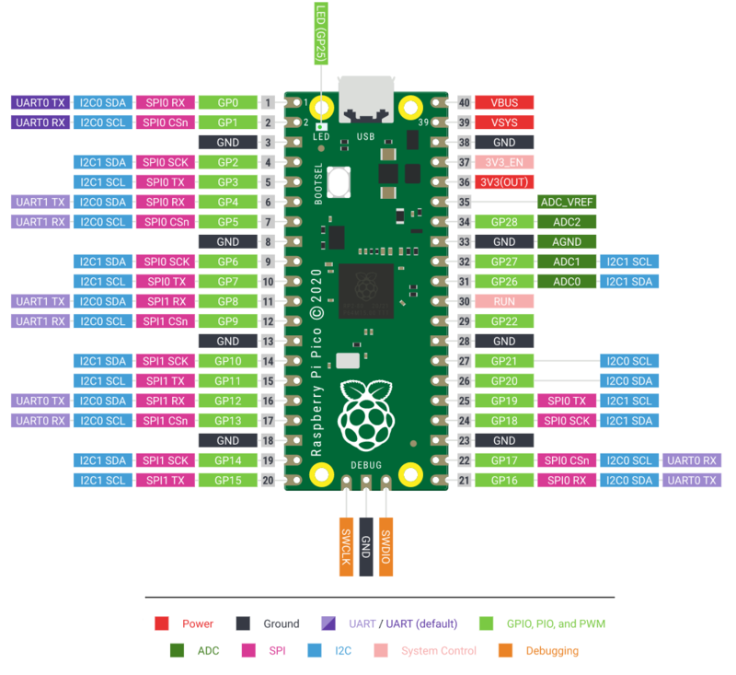
Pico Pinout

Slide 13
Programming I2C Device for Pico
Select a module that supports I2C
  Examples SSD1306 oLED display, ADXL345 Accelerometer, BME280 Combined Temperature/Humidity/Pressure sensor
Information needed before writing code:
  Datasheet
  MicroPython Library/Package – If any exists
  Example Programs – If any exist

Slide 14
Programming I2C Device for Pico – Datasheets
The datasheet provides the following information
  Pins and how to connect them to Pico
  Protocol that rides on top of I2C
  Commands and Data for controlling device
Control Flow for the device
  How to initialize
  How to change modes or behavior
  How to read and write data

Slide 15
Programming I2C Device for Pico – Libraries
Performs the low level work needed to control the device
  Performs the I2C byte-level communication
Provides API for basic commands
  Such as display text, read data, initialize device
Make sure Library is for the programming language you are using
  MicroPython vs CircuitPython
Use Thonny or Google to find libraries

Slide 16
Programming I2C Device for Pico – Libraries
ADXL345 Accelerometer
  Hass-python-adxl34x library
BME280 Combined Temperature/Humidity/Pressure Sensor
  micropython-bme280
LCD 20x4 Display
  RPI-PICO-I2C-LCD by T-622 on GitHub
SSD1306 oLED Display
  micropython-ssd1306

Slide 17
Programming I2C Device for Pico – Examples
Example Programs
  Provide source code for controlling the device.
    Make sure example uses the same or similar library
  Provide insight on how to use the device
    What steps are needed to prepare the device for use
    What steps are needed to obtain data from device
    For display devices, how to get text, images, pixels to actually be displayed

Slide 18
Programming I2C Device for Pico
If no library can be found
  You will need to write your own low-level library
  Use the datasheet to:
    Determine how to write to and read from the device using I2C
    What methods are needed based on the command set for the device
Command sets are usually mapped to registers or memory locations
  Registers are normally represented by a one byte hexadecimal value
  Registers usually have one byte data values that can be RO, WO, RW

Slide 19
SSD1306 OLED Display
OLED or oLED == Organic Light Emitting Diodes
OLED are bitmap displays
Common SSD1306 module is a 0.96” monochrome display
  With 128 x 64 pixels
  The foreground color is blue. Sometimes the first 15-20 rows of pixels may be a different color such as red or yellow
Multiple libraries are available to handle the low level work of running the display.
  My choice was micropython-ssd1306

Slide 20
SSD1306 OLED Display
The ssd1306 defines three classes
  SSD1306 – Base class derived from frame.FrameBuffer class
    This is an abstract class used by the following two classes
  SSD1306_I2C – Class that uses I2C to communicate with display
    This is the class we will use.
  SSD1306_SPI – Class that uses SPI to communicate with display
    SPI is another serial communication protocol that uses two shared wires for Data and Clock, plus a third dedicated wire instead of addresses.

Slide 21
SSD1306 OLED Display
The underlying FrameBuffer class contains methods for managing a bitmap display, such as the SSD1306
A set of primitive methods control pixels:
  The are fill(), pixel(), hline(), vline(), line(), rect(), elipse(), poly()
They are text() places text strings into the bit map
Extra methods for more complex operations:
  They are scroll(), blit()
Most important, SSD1306.show(), which causes changes to be sent to the display.

Slide 22
Simple OLED Program
## oled-demo.py
from machine import Pin, I2C
from ssd1306 import SSD1306_I2C
#i2c = I2C(0, sda=Pin(8), scl=Pin(9), freq=400000 )
i2c = I2C(1, sda=Pin(6), scl=Pin(7), freq=400000 )
display = SSD1306_I2C( 128, 64, i2c, addr=0x3C )
display.text("Hello World!", 0,0,1)
display.hline(0, 10, 128, 1)
display.vline(100, 0, 64, 1)
display.show()

Slide 23
LCD Displays
LCD Displays are character based displays
Two common sizes are 16x2 characters and 20x4 characters
  16 and 20 are the number characters in a row
  2 and 4 are the number of rows
LCD Displays normally use a lot of GPIO pins
LCD Displays with I2C interfaces uses 2 GPIO pins plus a Vcc and Ground connection

Slide 24
LCD Displays
MicroPython libraries for LCD Displays are not as common as the libraries for the SSD1306
The micropython-lcd library on pypi.org is a dummy library.
  No content or code
  PyPi is where Thonny searches for packages
Libraries are available on GitHub
  I use https://github.com/T-622/RPI-PICO-I2C-LCD.git
  By Tyler Peppy -- T-622

Slide 25
ADXL345 Accelerometer
The ADXL345 measures acceleration
  In X, Y, and Z axes
  Measures dynamic and static acceleration
    Dynamic acceleration of movement
    Static acceleration of gravity
Uses either SPI or I2C communication protocols
  Communication protocol selected by CS Pin
  For this presentation, we will only be using I2C

Slide 26
ADXL345 Accelerometer
Has an 8 pin interface
  4 pins for I2C and SPI communications
  CS pin to select protocol
    High for I2C and Low for SPI
  SDO – Serial Data Output
    If CS is Low, SDO is for SPI as Serial Data Output
    If CS is High, I2C Address – High for 0x1D and Low for 0x53
  2 pins to generate interrupts

Slide 27
References – This Presentation
GitHub – Repository Robot-Maker for “Pico and I2C Talk”
  https://github.com/sflebrun/Robot-Maker
Directory containing Source Code and Presentation Documents
  https://github.com/sflebrun/Robot-Maker/tree/main/Pico%20and%20I2C%20Talk

Slide 28
References – ADXL345
Datasheet
  https://www.analog.com/media/en/technical-documentation/data-sheets/adxl345.pdf
ADXL345 and Pico using MicroPython
  https://www.digikey.com/en/maker/projects/raspberry-pi-pico-rp2040-i2c-example-with-micropython-and-cc/47d0c922b79342779cdbd4b37b7eb7e2

Slide 29
References – I2C
I2C Bus, Interface, and Protocol
  https://i2c.info/
I2C Bus Specification
  https://i2c.info/i2c-bus-specification
UM10204 – I2C Bus Specification and User Manual
  https://www.nxp.com/docs/en/user-guide/UM10204.pdf

Slide 30
References – LCD Display
Library used in GitHub
  https://github.com/T-622/RPI-PICO-I2C-LCD.git
Library contains two files that need to be copied to Pico
  lcd_api.py
    Abstract base class LcdApi for operating LCD Displays
    Imported indirectly pico_i2c_lcd
  pico_i2c_lcd.py
    Class I2cLcd, derived from LcdApi
    Adds I2C functionality to LCD communication

Slide 31
References – MicroPython
Overview – MicroPython 1.19.1 Documentation
  https://docs.micropython.org/en/latest/index.html
Class I2C – a two-wire serial protocal
  https://docs.micropython.org/en/latest/library/machine.I2C.html?highlight=i2c#machine.I2C
Class FrameBuffer – for creating and manipulating bitmaps
  https://docs.micropython.org/en/latest/library/framebuf.html
Class Pin – Control GPIO Pins
  https://docs.micropython.org/en/latest/library/machine.Pin.html

Slide 32
References – Pico
Raspberry Pi Pico [W] Pinout
  https://datasheets.raspberrypi.com/picow/PicoW-A4-Pinout.pdf
Raspberry Pi Pico SDK Documentation V1.4.0
  https://raspberrypi.github.io/pico-sdk-doxygen/index.html
Class machine.I2C for Pico
  https://docs.micropython.org/en/latest/library/machine.I2C.html
  https://wiki.sipeed.com/soft/maixpy/en/api_reference/machine/i2c.html

Slide 33
References – SSD1306
Datasheet
  https://www.elecrow.com/download/SSD1306%20Datasheet.pdf
OLED 4 Pin 128 x 64 Display Module 0.96”
    https://www.rajguruelectronics.com/Product/1145/OLED%204%20Pin%20128x64%20Display%20module%200.96%20inch%20blue%20color.pdf
SSD1306 Demo V3
  https://www.instructables.com/SSD1306-With-Raspberry-Pi-Pico/?fbclid=IwAR0Eg8xfaiJfQH-qZjBUu31SCgZRet8Qgi7HSJ0NvJ9zgLF8q60sfZ62Hp0

